Slide 1
Supplement 246 – DICOMweb Modality Services WG27 Public Comment
January 2025

Slide 2
Work item 2023-10-C – DICOMweb Modality Services
Introduction
The DICOM Standard defines several services. Two of these are targeted towards modalities, namely the Modality Worklist service (see PS3.4, Annex K, more specifically K.6.1) and the Modality Performed Procedure Step service (see PS3.4, Annex F, more specifically F.7-F.9). Currently, these services are defined using DIMSE.
Limitations of Current Standard
Both the Modality Worklist service and the Modality Performed Procedure Step service are not yet available in DICOMweb. This limits a) the uptake of DICOMweb for modalities and b) the support of workflow services for modalities that are (intended to be) part of a web-based ecosystem.
Description of Proposal
Add the Modality Worklist and the Modality Performed Procedure Step services to DICOMweb, in principle based on the existing DICOMweb Worklist service (UPS-RS; see PS3.18, section 11). This would boil down to creating an informative annex and any normative changes needed if gaps are discovered.

Slide 3
Progress
Done since last meeting
This presentation (although largely based on previous version)
Agenda
Recap of previous discussion
Look at incompatibilities between MWL/MPPS and UPS data models
Decide on way forward
Discuss and conclude on what HTTP method to be used for updates

Slide 4
Observations
Mapping DIMSE MWL/MPPS to UPS(-RS) and vice versa has insurmountable problems, related to
Compatibility – taking away incompatibilities would require a) breaking changes and b) a tremendous amount of work (which would be beyond the scope of this supplement)
Efficiency – mapping all attributes in both directions would require a large amount of effort (even after having made the information models compatible)
Sticking the head in the sand by ignoring the inherent complexities and ‘just’ looking at some straightforward use cases will give the wrong impression (and will lead to backtracking, and not just one time)
Usability – it would result in a specification that is very complex to use, aiming for low adoption to begin with
Implementing proxies (for hybrid settings with DIMSE and DICOMweb systems) would be very cumbersome and error-prone due to the huge amount of details
It is, however, straightforward to map DIMSE MWL/MPPS to new DICOMweb services and resources, e.g.
C-FIND_{MWL} GET SP /modality-worklist?{&match*}{&includefield}{&fuzzymatching}{&offset}{&limit} SP version CRLF
N-CREATE_{MPPS} PUT SP /modality-performed-procedure-steps/{mppsUID} SP version CRLF CRLF payload
N-SET_{MPPS} PATCH SP /modality-performed-procedure-steps/{mppsUID} SP version CRLF CRLF payload
N-GET_{MPPS} GET SP /modality-performed-procedure-steps/{mppsUID} SP version CRLF
N-EVENT-REPORT_{MPPS} POST SP /modality-performed-procedure-steps/{mppsUID}/subscribe/{aetitle} SP version CRLF DELETE SP /modality-performed-procedure-steps/{mppsUID}/subscribe/{aetitle} SP version CRLF
The above would be complete by definition, covering all possible use cases and all inherent complexity
MPPS Notifications are an intrinsic exception, as there is an issue with the Standard not having specified how SCPs know what SCUs to notify

Slide 5
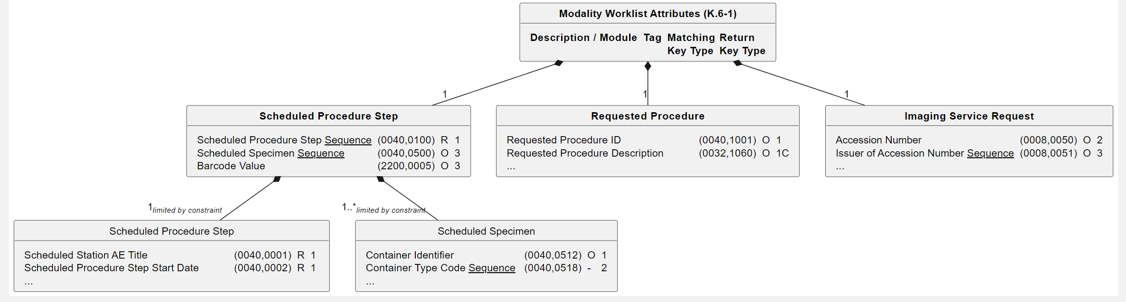
Analysis of Information Models – Introduction
Graphical representation of tables as UML class diagrams
Each table is represented by a class, having a bold name, showing the (relevant) columns
Each sub-table (identified by a bold heading in the table) is represented by a class having a bold name which is contained in the table class (1:1)
Sequences are underlined, to signify the fact that elements of each sequence are represented by a class, contained in the class using the sequence (0:n when unconstrained)
Diagrams contain only explicitly mentioned sequences, not those in All [other] Attributes …
Each inclusion is represented by a class, contained in the including class, that shows the include italic
Implicit attributes (included by All [other] Attributes …) are given starting with a dash
Description / Module | Tag | Matching Key Type | Return Key Type
Scheduled Procedure Step
Scheduled Procedure Step Sequence | (0040,0100) | R | 1
>Scheduled Station AE Title | (0040,0001) | R | 1
>Scheduled Procedure Step Date | (0040,0002) | R | 1
>…
Scheduled Specimen Sequence | (0040,0500) | O | 3
>Container Identifier | (0040,0512) | O | 1
>Container Type Code Sequence | (0040,0518) | - | 2
>…
Barcode Value | (2200,0005) | O | 3
Requested Procedure
Requested Procedure ID | (0040,1001) | O | 1
Requested Procedure Description | (0032,1060) | O | 1C
…
Imaging Service Request
Accession Number | (0008,0050) | O | 2
Issuer of Accession Number Sequence | (0008,0051) | O | 3
…

Slide 6
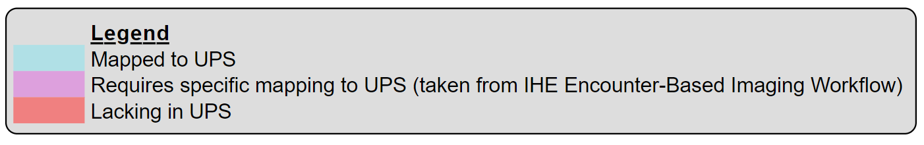
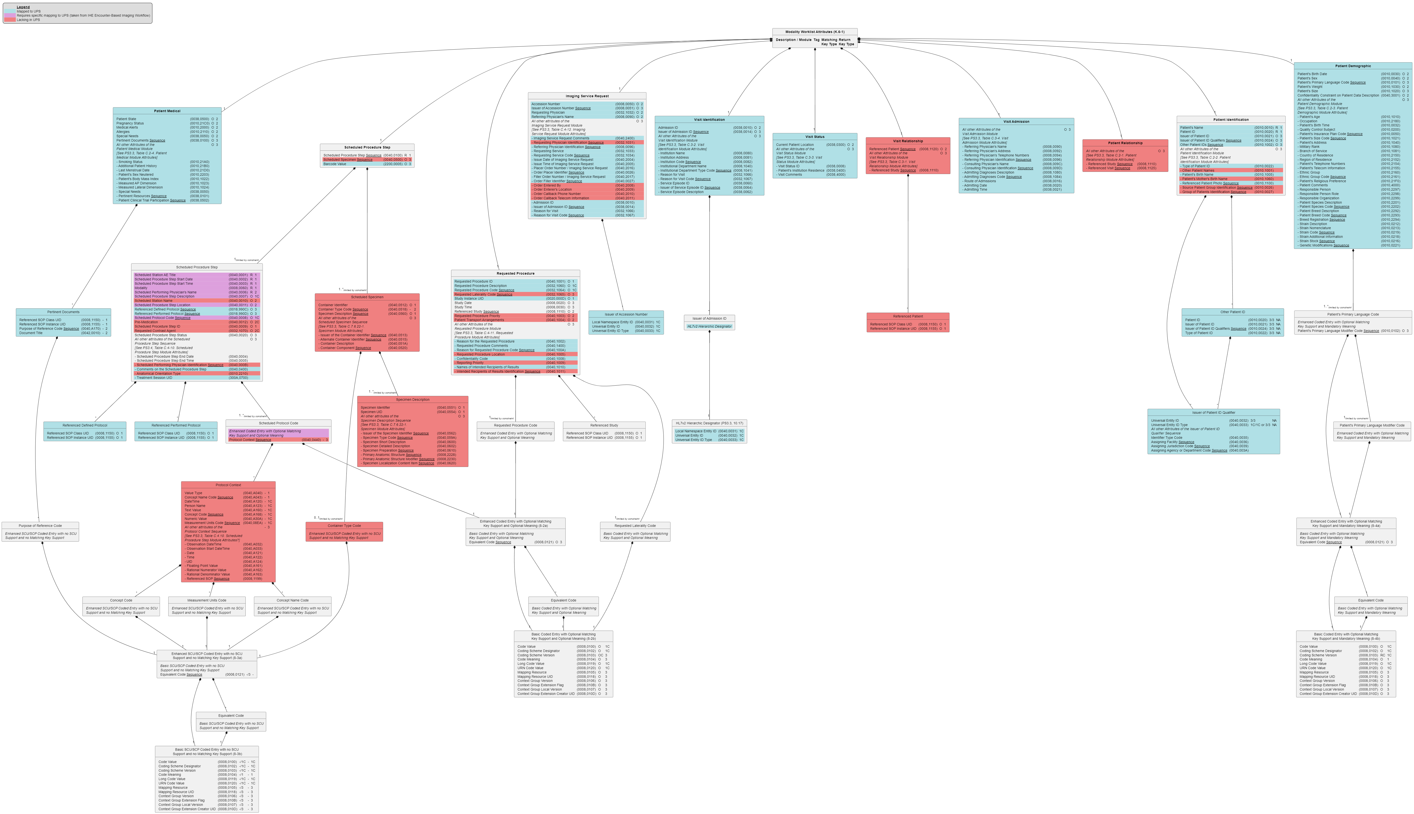
Analysis of Information Models – MWL
Lacking in UPS
Modules/Sequences
Visit Relationship
Patient Relationship
Specimen
…
Attributes
Scheduled Procedure Step ID
Requested Contrast Agent
Other Patient Names
…
Incompatibility
MWL’s Scheduled Protocol Code Sequence has two parts, of which the Protocol Context Sequence is not part of the UPS’s Scheduled Workitem Code Sequence to which EBIW maps it.
Furthermore, there’s no distinction between ‘primary’ and equivalent codes in UPS.

Slide 7
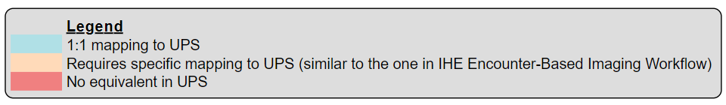
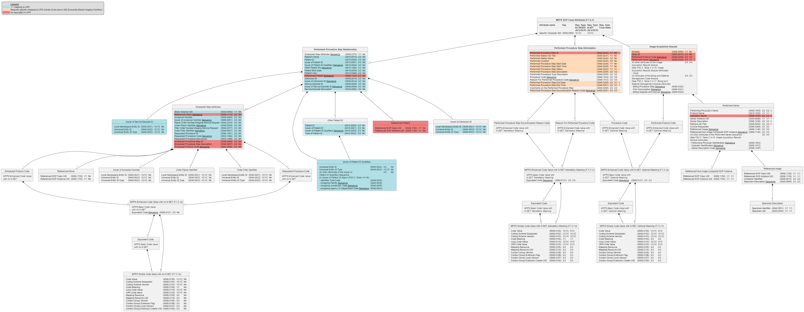
Analysis of Information Models – MPPS
Incompatibility
Is mapping from MPPS’ Performed Procedure Step Status DISCONTINUED to / from UPS’ Procedure Step State CANCELLED semantically correct? And what about the SCHEDULED value?
Lacking in UPS
Modules/Sequences
Referenced Patient
Referenced Study
…
Attributes
Scheduled Procedure Step ID
Scheduled Procedure Step Description
…
Incompatibility Mapping from MPPS’ Performed Procedure Step Discontinuation Reason Code Sequence to / from UPS’ Procedure Step Discontinuation Reason Code Sequence is possible, as both allow for multiple codes, but in MPPS there is one ‘primary’ code with possible equivalents, while UPS does not state how the codes are related.

Slide 8
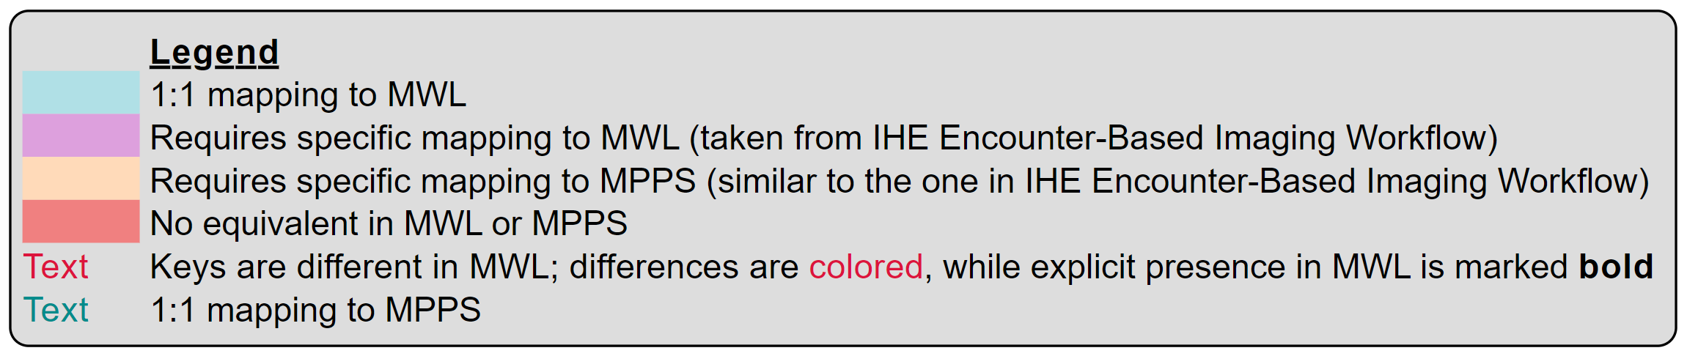
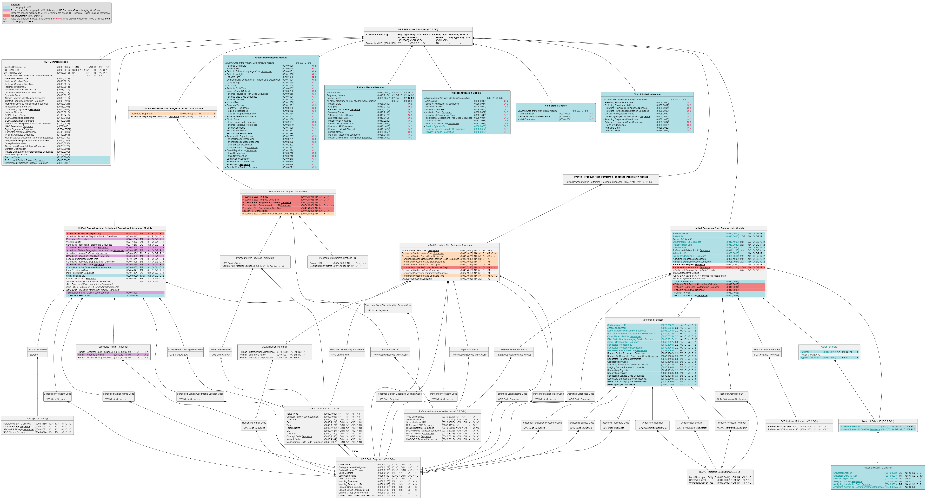
Analysis of Information Models – UPS
Lacking in MWL/MPPS
Modules/Sequences
…
Attributes
* Alternative Calendar *
* Progress *
* Cancellation *
Scheduled Procedure Step Priority
…
Incompatibilities
Cardinality
In MWL Imaging Service Request has a 1:1 relationship, while in UPS
Referenced Request has a 1:n
Relationship.
In MPPS the Performed Procedure
Step has a 1:1 relationship, while in
UPS the Performed Procedure Step
has a 1:n relationship.
Attribute Keys
For many attributes in ‘shared’
modules, keys have been defined
differently (MWL: O and 2 or 3 and UPS - and -.

Slide 9
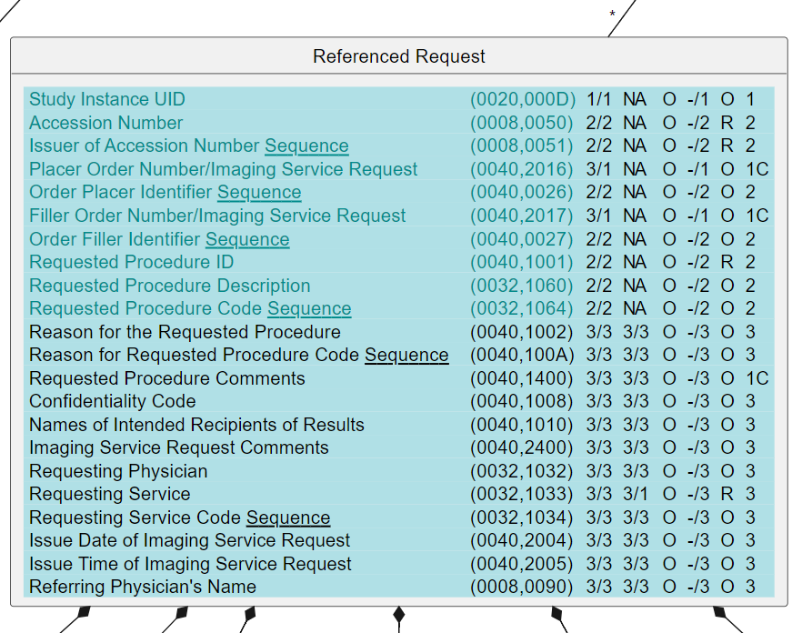
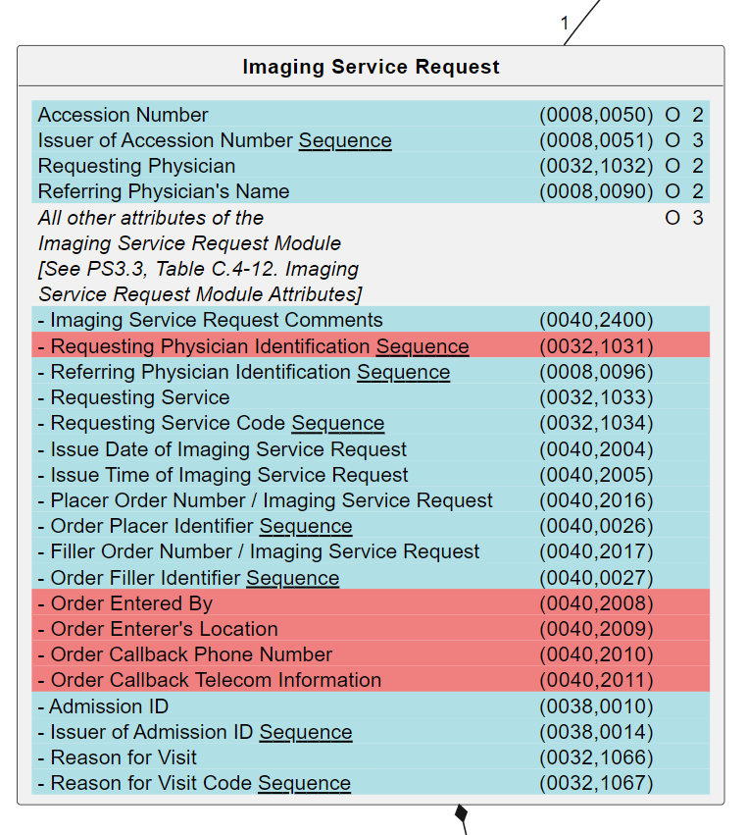
Breaking Changes for Mapping MWL/MPPS to UPS (1)
Request
UPS’ Referenced Request (RR) and MWL’s Imaging Service Request (ISR) serve a similar goal, recording what has been requested:
However, UPS has a 0:n relationship with RR – (0040,A370) Referenced Request Sequence (RRS) – while MPPS has a 1:1 relationship with ISR
page 397
page 244

Slide 10
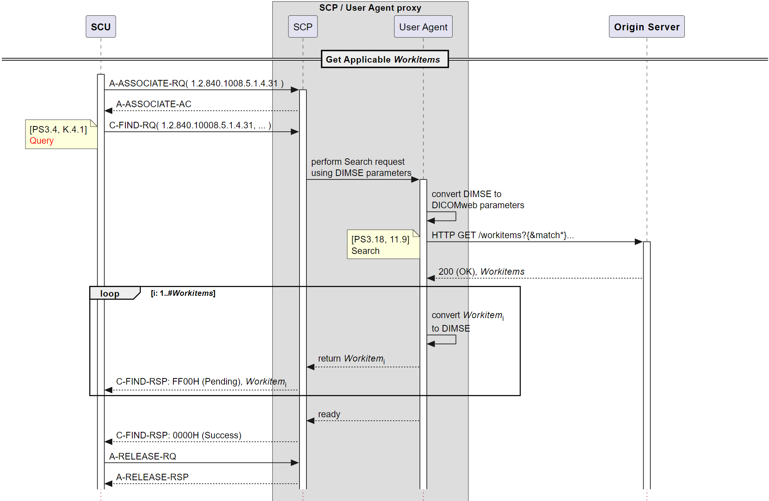
Breaking Changes for Mapping MWL/MPPS to UPS (1)
A proxy for an MWL/MPPS client and UPS server needs to map the referenced requests of UPS to the MWL imaging service request.
In case the retrieved Referenced Request Sequence in UPS has 0 or more than 1 elements, this is not mappable to an Imaging Service Request.
Therefore, a change would be needed, but that would break at least one current definition.
including RRS attributes, e.g. Accession Number
including ISR attributes, e.g. Accession Number
All Workitems have a sequence of Accession Numbers
How to convert a sequence of Accession Numbers to one instance??

Slide 11
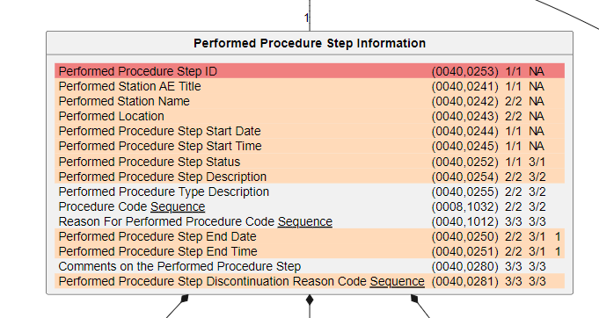
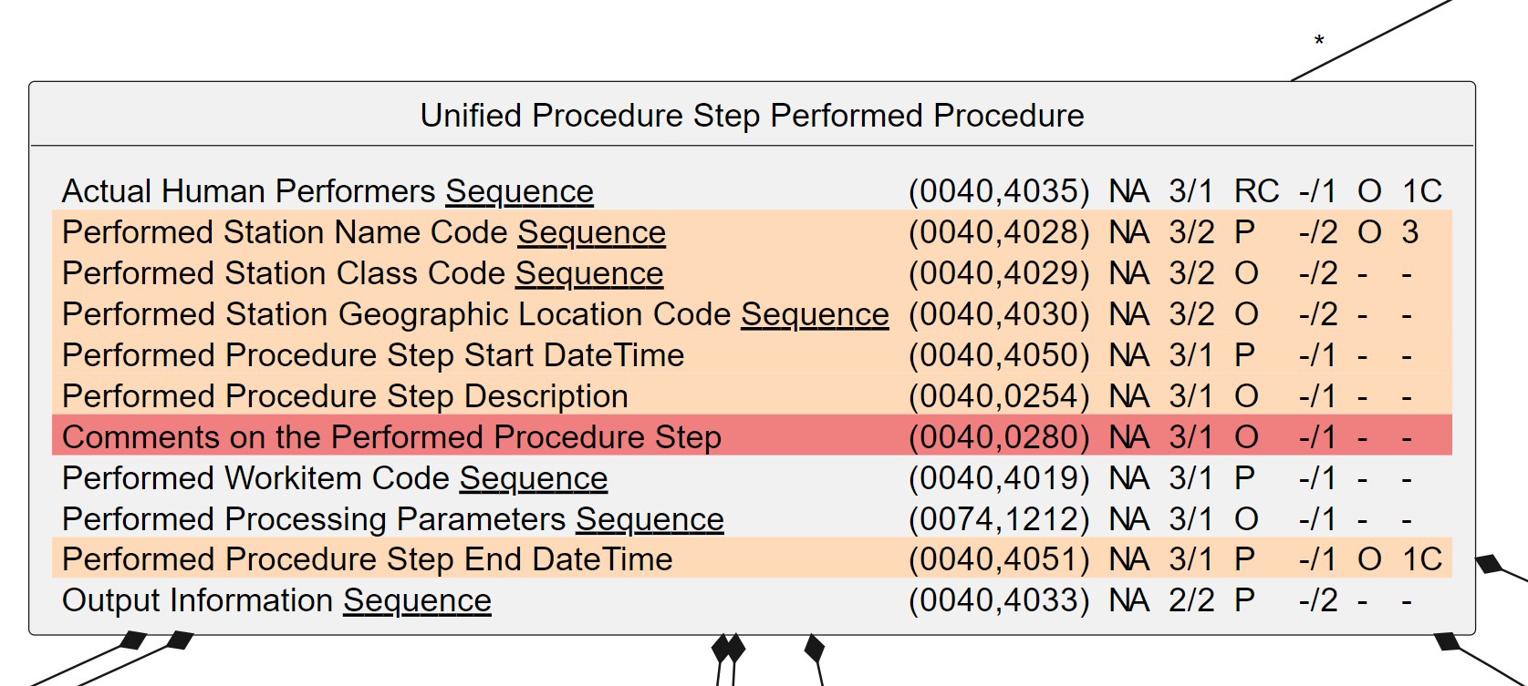
Breaking Changes for Mapping MWL/MPPS to UPS (2)
Performed
UPS’ Unified Procedure Step Performed Procedure (UPSPP) and MPPS’ Performed Procedure Step Information (PPSI) serve a similar goal, recording what has been performed:
However, UPS has a 0:n relationship with UPSPP – (0074,1216) Unified Procedure Step Performed Procedure Sequence (UPSPPS), while MPPS has a 1:1 relationship with PPSI
page 400
page 166

Slide 12
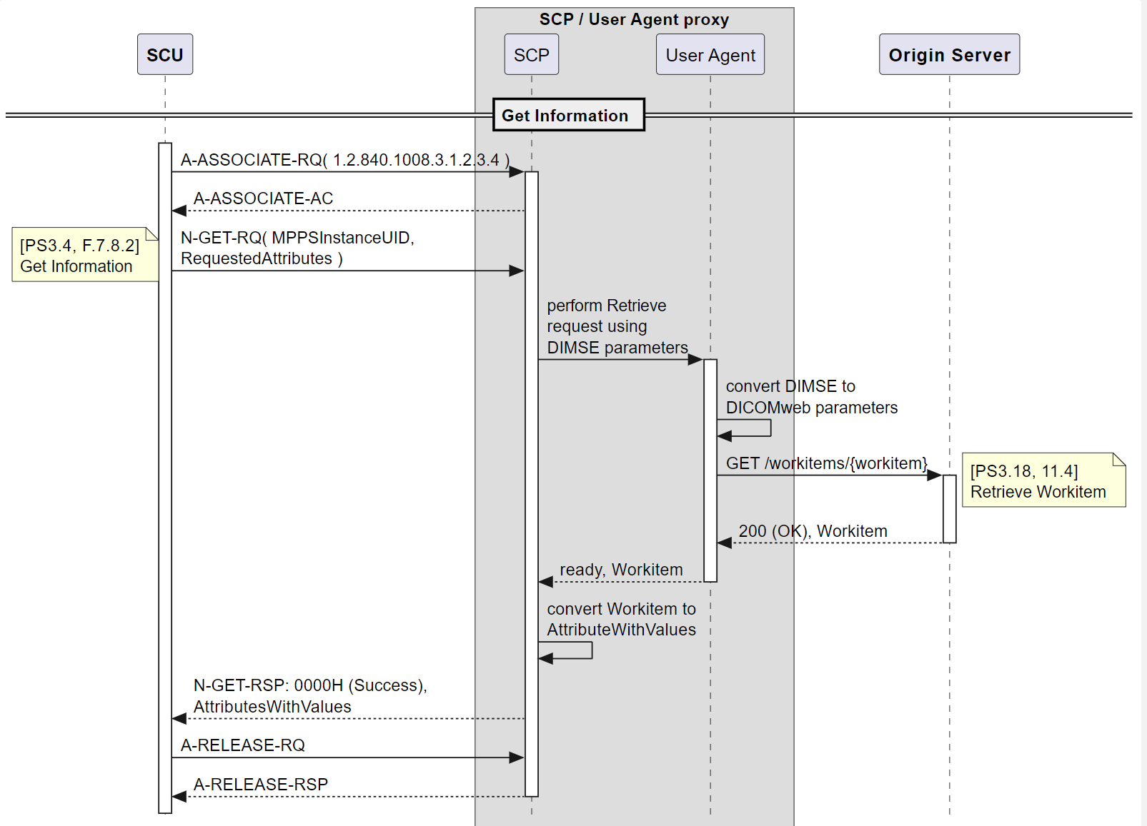
Breaking Changes for Mapping MWL/MPPS to UPS (2)
A proxy for an MWL/MPPS client and UPS server needs to map UPS’ performed procedure of UPS to the MWL performed procedure step information.
In case the retrieved performed procedure sequence in UPS has 0 or more than 1 elements, this is not mappable to MWL’s performed procedure step information.
Therefore, a change would be needed, but that would break at least one current definition.
including PPS attributes, e.g. PPS Description
including PPSI attributes, e.g. PPS Description
How to convert a sequence of PPS Descriptions to one instance??

Slide 13
Breaking Changes for Mapping MWL/MPPS to UPS (3)
Mapping of items that have different semantics is not possible unless one of the definitions changes, but that would lead to a breaking change.
MWL and MPPS exhibit patterns for structures identifying several equivalent codes next to one ‘primary’ code. Structures in UPS just define a bunch of codes without any relations. This is unmappable without consequences.
Examples include the (Performed) Procedure Step Discontinuation Reason Code Sequences and the Scheduled Workitem Code Sequence (UPS) vs. the Schedule Protocol Code Sequence (MWL).
The states of a UPS are {SCHEDULED, IN PROGRESS, COMPLETED, CANCELED}, while the states of MPPS are {IN PROGRESS, COMPLETED, DISCONTINUED}. How are these to be mapped without unwanted consequences?
Notifications in UPS can contain quite some details (see PS3.4, Table CC.2.4-1. Report a Change in UPS Status - Event Report Information) while notifications in MPPS do not have details (Table F.9.2-1. Performed Procedure Step Notification Event Information). This is unmappable without consequences. And we’re even not looking at the Event Type differences here …

Slide 14
Breaking Changes for Mapping MWL/MPPS to UPS (4)
Undefined
The meaning of “-” for Matching and Return Key Type – Table K.6.1 and tables in CC.2.5.1.2 – seems undefined.
It is assumed that “-” means Undefined, as is for the N-CREATE, N-SET, and N-ACTION (see PS3.4, Section 5.4.2.1). This is equal to “The SCP’s support of the Attribute is undefined.”
Matching Key Type and Return Key Type for many attributes are then defined as being Undefined in UPS while these are defined as O and 2 (or 3) in MWL.
This creates a mapping issue. When an MWL SCU queries a UPS SCP implementation using one of these keys, one kind of implementation could match on it, and another one would not, also when having the same Scheduled Procedure Steps.
The above behavior is not interoperable and does require a change when mapping between MWL and UPS, but that would break a current definition.
What if the “-” for Matching and Return Key Types means that it is not allowed?
That would lead to an even a stronger case for a breaking change; can be requested in MWL/MPPS but not available in UPS.

Slide 15
Conclusion
Mapping DIMSE MWL/MPPS to UPS(-RS) and vice versa has insurmountable problems, related to
Compatibility – taking away incompatibilities would require a) breaking changes and b) a tremendous amount of work (which would be beyond the scope of this supplement)
Efficiency – mapping all attributes in both directions would require a large amount of effort (even after having made the information models compatible)
Sticking the head in the sand by ignoring the inherent complexities and ‘just’ looking at some straightforward use cases will give the wrong impression (and will lead to backtracking, and not just one time)
Usability – it would result in a specification that is very complex to use, aiming for low adoption to begin with
Implementing proxies (for hybrid settings with DIMSE and DICOMweb systems) would be very cumbersome and error-prone due to the huge amount of details
It is, however, straightforward to map DIMSE MWL/MPPS to new DICOMweb services and resources, e.g.
C-FIND_{MWL} GET SP /modality-worklist?{&match*}{&includefield}{&fuzzymatching}{&offset}{&limit} SP version CRLF
N-CREATE_{MPPS} PUT SP /modality-performed-procedure-steps/{mppsUID} SP version CRLF CRLF payload
N-SET_{MPPS} PATCH SP /modality-performed-procedure-steps/{mppsUID} SP version CRLF CRLF payload
N-GET_{MPPS} GET SP /modality-performed-procedure-steps/{mppsUID} SP version CRLF
N-EVENT-REPORT_{MPPS} POST SP /modality-performed-procedure-steps/{mppsUID}/subscribe/{aetitle} SP version CRLF DELETE SP /modality-performed-procedure-steps/{mppsUID}/subscribe/{aetitle} SP version CRLF
The above would be complete by definition, covering all possible use cases and all inherent complexity
MPPS Notifications are an intrinsic exception, as there is an issue with the Standard not having specified how SCPs know what SCUs to notify
It is therefore proposed to create new Modality Services resources instead of basing DICOMweb Modality Services on UPS-RS

Slide 16
What HTTP Method is to be Used for Updates etc?
PATCH versus PUT and POST
The PUT method provides a replacement of the entire resource (and thus requires bandwidth).
The POST method doesn’t have any generic semantics.
“Server and client-side developers must write application-specific code to support it, then do QA on it, debug the corner cases, and eventually rewrite the API to fix the problems they inevitably find (partial updates can get subtle). Once you get a lot of these hanging around, it’s a pain.”
The PATCH method is a request method for making partial changes to an existing resource.
It is atomic, so either all or no changes
The current PUT for the Change Workitem State Transaction in UPS-RS is weird
Requires a separate resource for changing a state, not the intent of HTTP

Slide 17
References
This presentation, the examples and the analysis images (and much more) can be found at
https://github.com/krotz-dieter/dicomweb-dmwl-mpps

